Slide 1
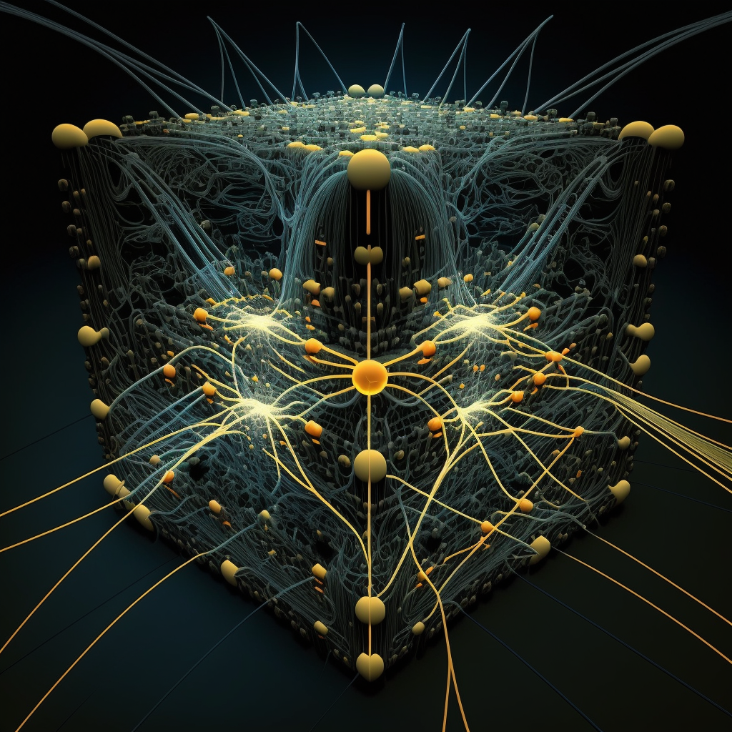

deep neural networks
midjourney bot (2023)
Machine Learning Methods for Biomedical Data (D012554)

Slide 2
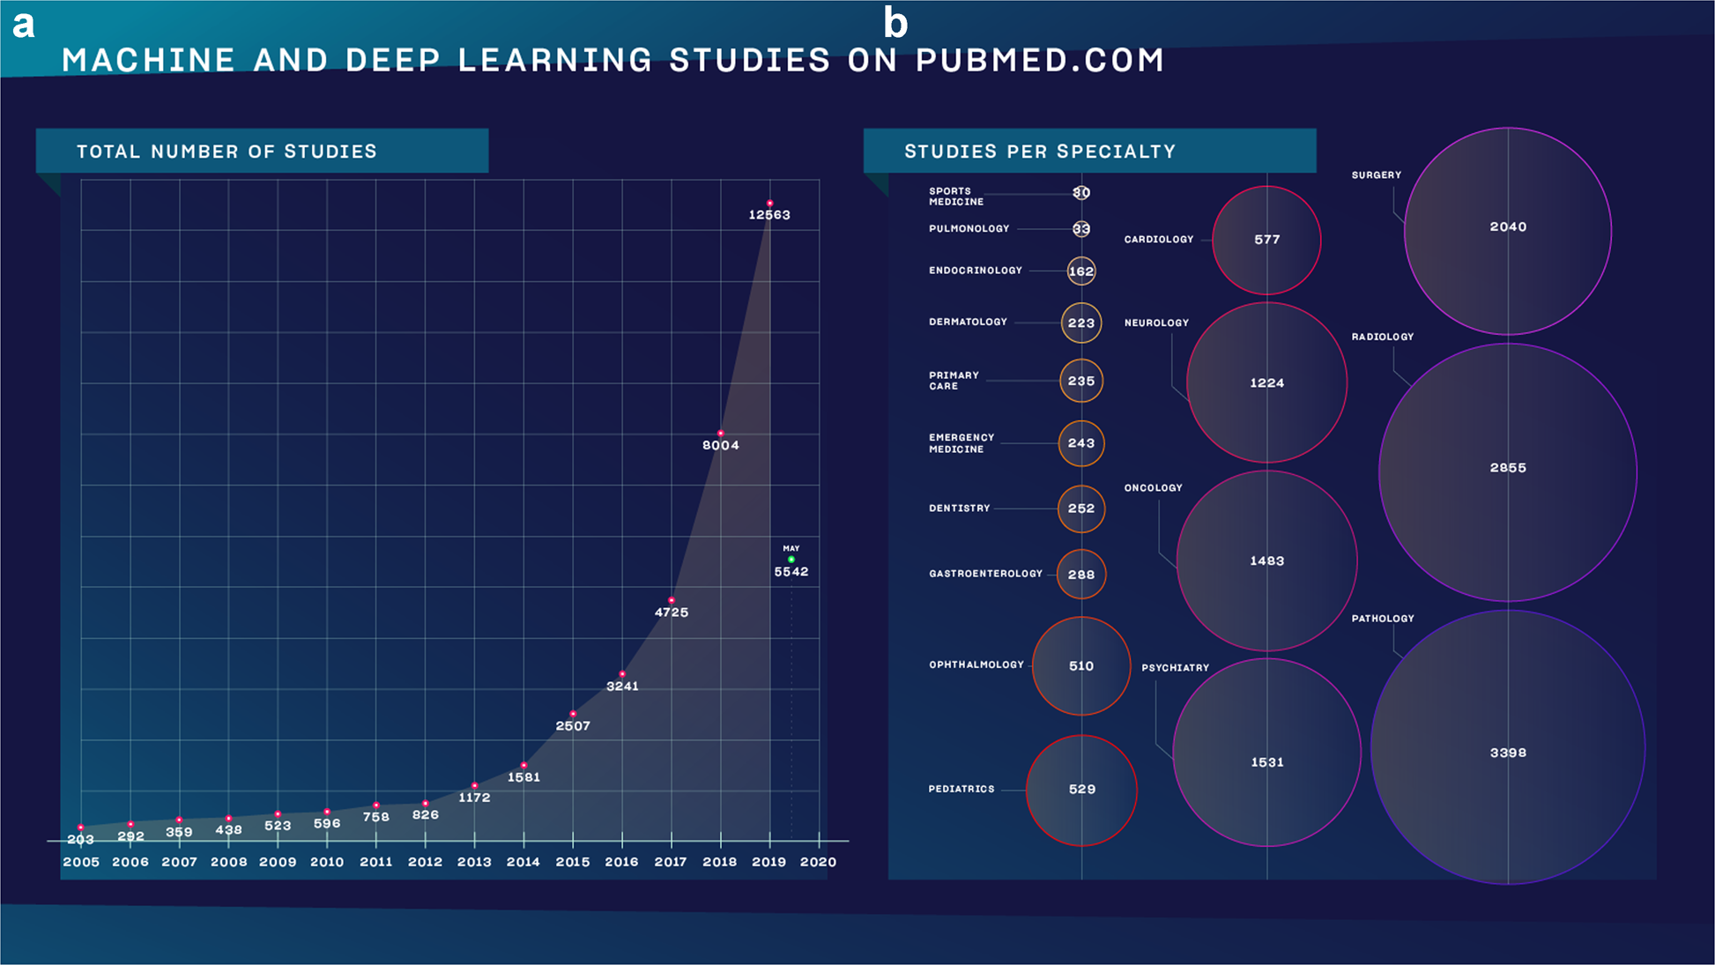
deep learning
Meskó, B., Görög, M. A short guide for medical professionals in the era of artificial intelligence. npj Digit. Med. 3, 126 (2020)
Machine Learning Methods for Biomedical Data (D012554)
Notes:
Also convex!

Slide 3
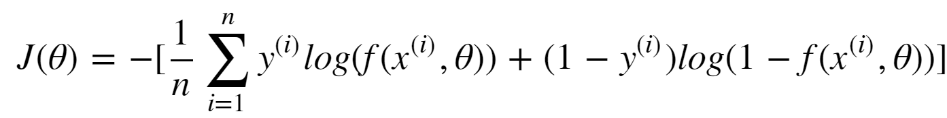
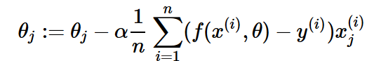
logistic regression
Fit a logistic model
such that the cost function
is minimised with the gradient descent algorithm:
Machine Learning Methods for Biomedical Data (D012554)
Notes:
Also convex!

Slide 4
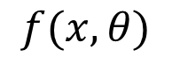
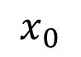
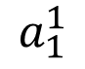
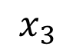
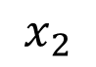
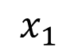
neural network
We can visualize a logistic regression model as follows:
$$x_{0}$$
$$x_{1}$$
$$a_{1}^{1}$$
$$f(x,θ)$$
$$x_{2}$$
$$x_{3}$$
Machine Learning Methods for Biomedical Data (D012554)
Notes:
Also convex!

Slide 5
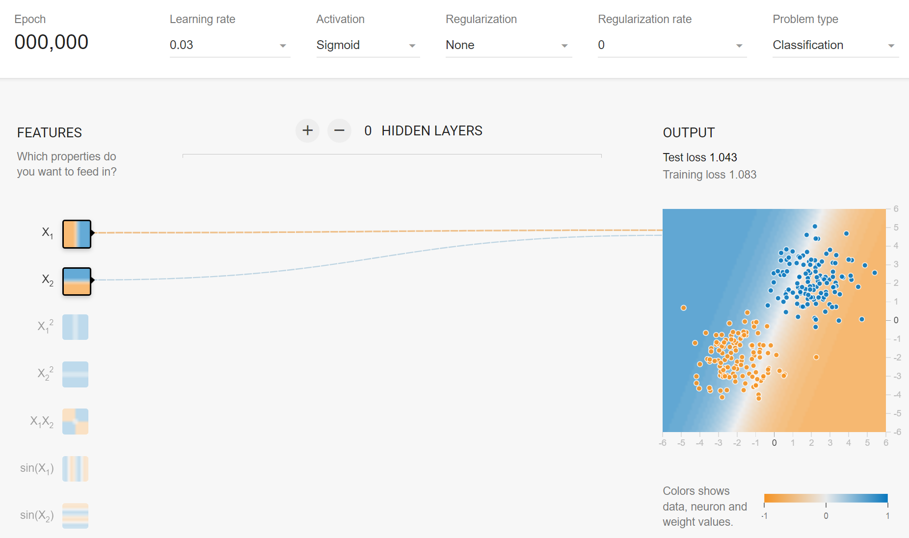
neural network
We can visualize a logistic regression model as follows (ctrl-click image):
Machine Learning Methods for Biomedical Data (D012554)
Notes:
Also convex!

Slide 6
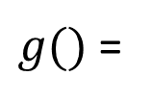
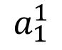
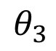
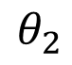
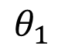
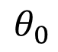
neural network
We can visualize a logistic regression model as follows:
$$x_{0}$$
$$θ_{0}$$
$$x_{1}$$
$$θ_{1}$$
$g()$ =
$$a_{1}^{1}$$
$$f(x,θ)$$
$$θ_{2}$$
$$x_{2}$$
$$θ_{3}$$
$$x_{3}$$
Machine Learning Methods for Biomedical Data (D012554)
Notes:
Also convex!

Slide 7
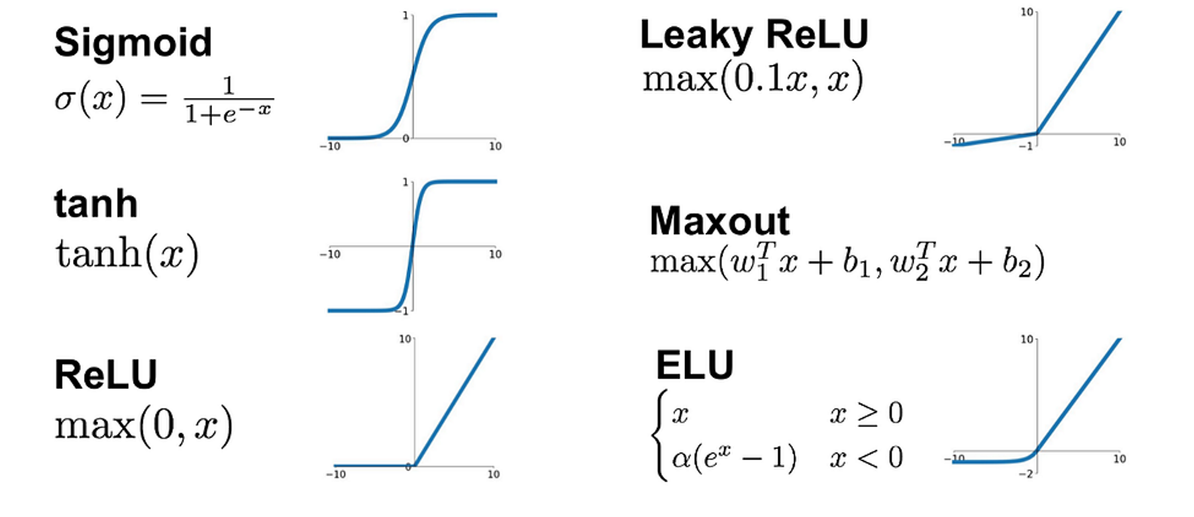
non-linearity: activation functions g()
We can employ different types of activation functions.
They need to be non-linear (and ‘differentiable…..ReLU?...’).
Machine Learning Methods for Biomedical Data (D012554)
Notes:
Also convex!

Slide 8
neural network
We can visualize a logistic regression model as follows:
$$x_{0}$$
$$x_{1}$$
$$a_{1}^{1}$$
$$f(x,θ)$$
$$x_{2}$$
$$x_{3}$$
Machine Learning Methods for Biomedical Data (D012554)
Notes:
Also convex!

Slide 9
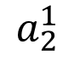
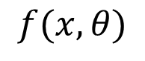
neural network
A neural network is an architecture that consists of logistic models:
An additional logistic model is added as a node in the model’s first (hidden) layer.
$$x_{0}$$
$$x_{1}$$
$$a_{1}^{1}$$
$$x_{2}$$
$$a_{2}^{1}$$
$$f(x,θ)$$
$$x_{3}$$
Machine Learning Methods for Biomedical Data (D012554)
Notes:
Also convex!

Slide 10
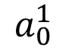
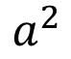
neural network
A neural network is an architecture that consists of logistic models:
An additional logistic model is added as a node in the model’s first (hidden) layer, followed by a logistic regression model in the output layer.
$$x_{0}$$
$$a_{0}^{1}$$
$$x_{1}$$
$$a_{1}^{1}$$
$$x_{2}$$
$$a_{2}^{1}$$
$$a^{2}$$
$$f(x,θ)$$
$$x_{3}$$
Machine Learning Methods for Biomedical Data (D012554)
Notes:
Also convex!

Slide 11
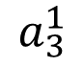
neural network
A neural network is an architecture that consists of logistic models:
More additional logistic models can be added as nodes in the model’s first (hidden) layer, followed by a logistic regression model in the output layer.
$$x_{0}$$
$$a_{0}^{1}$$
$$x_{1}$$
$$a_{1}^{1}$$
$$x_{2}$$
$$a_{2}^{1}$$
$$a^{2}$$
$$f(x,θ)$$
$$x_{3}$$
$$a_{3}^{1}$$
…
Machine Learning Methods for Biomedical Data (D012554)
Notes:
Also convex!

Slide 12
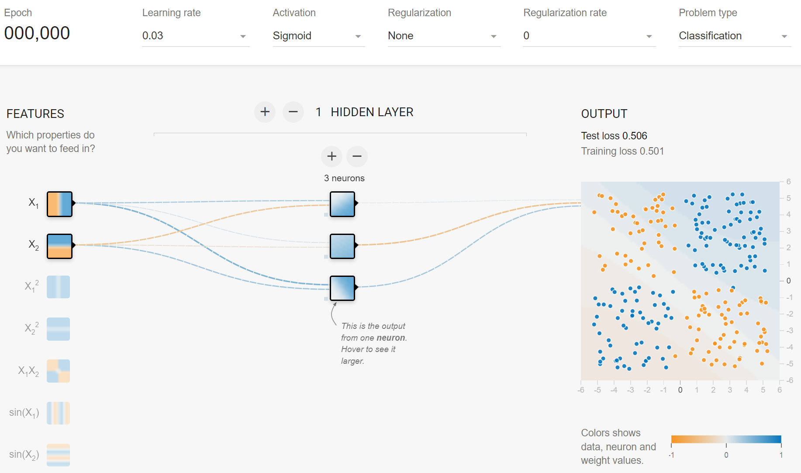
neural network
A neural network is an architecture that consists of logistic models (ctrl-click image):
More additional logistic models can be added as nodes in the model’s first (hidden) layer, followed by a logistic regression model in the output layer.
Machine Learning Methods for Biomedical Data (D012554)
Notes:
Also convex!

Slide 13
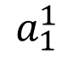
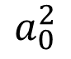
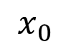
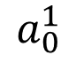
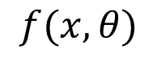
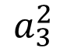
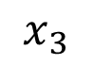
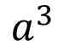
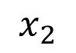
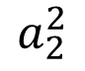
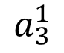
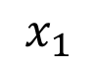
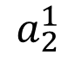
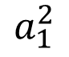
(deep) neural network
A neural network is an architecture that consists of logistic models:
We can also add a second (or more) layer of nodes to the model, followed by an output layer.
$$x_{0}$$
$$a_{0}^{1}$$
$$a_{0}^{2}$$
$$x_{1}$$
$$a_{1}^{1}$$
$$a_{1}^{2}$$
$$a^{3}$$
$$f(x,θ)$$
$$x_{2}$$
$$a_{2}^{1}$$
$$a_{2}^{2}$$
$$x_{3}$$
$$a_{3}^{1}$$
$$a_{3}^{2}$$
…
…
Machine Learning Methods for Biomedical Data (D012554)
Notes:
Also convex!

Slide 14
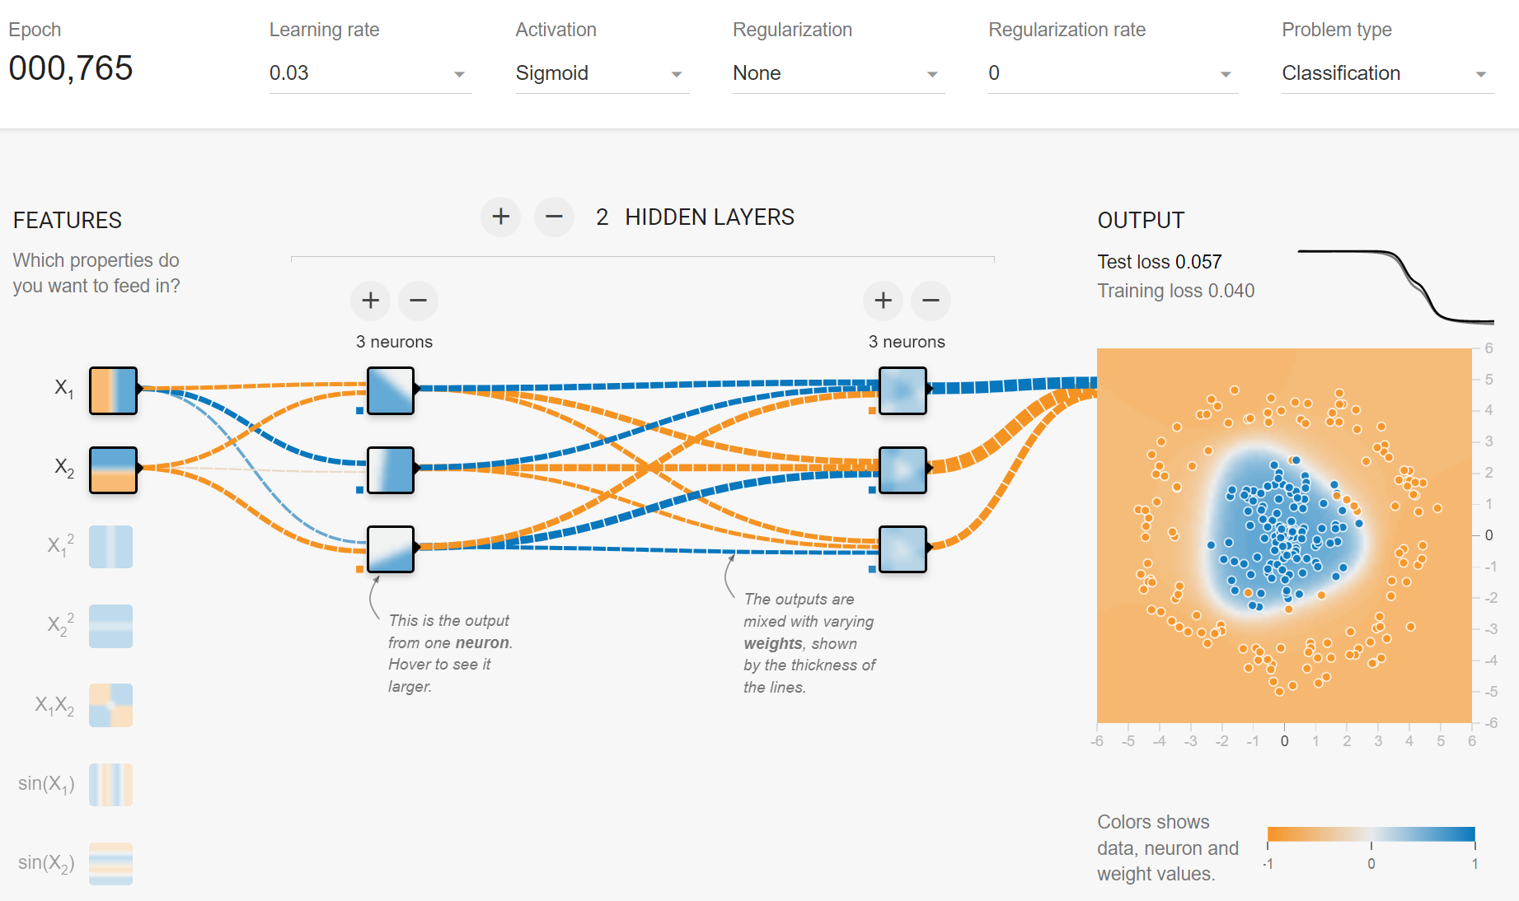
(deep) neural network
A neural network is an architecture that consists of logistic models (ctrl-click image):
We can also add a second (or more) layer of nodes to the model, followed by an output layer.
Machine Learning Methods for Biomedical Data (D012554)
Notes:
Also convex!

Slide 15
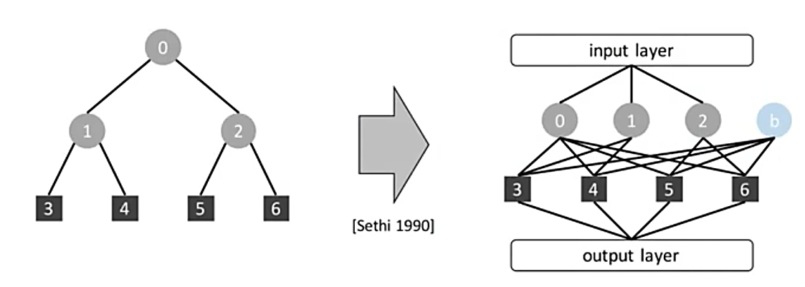
(deep) neural network
A neural network is somewhat similar to a decision tree.
hidden layer 1
hidden layer 2
Sethi I.K., Proceedings of the IEEE (1990)
Machine Learning Methods for Biomedical Data (D012554)
Notes:
Also convex!

Slide 16
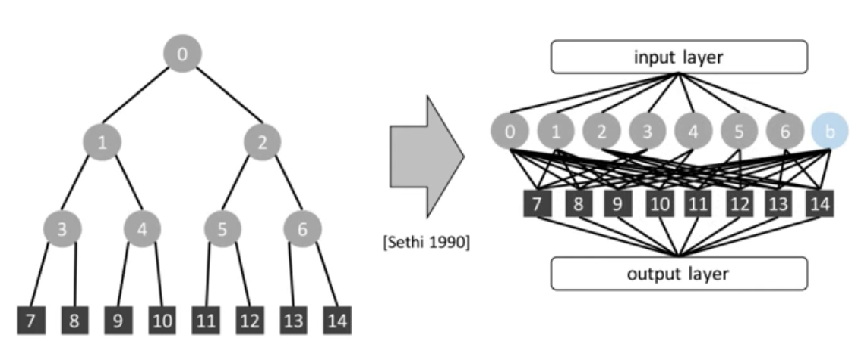
(deep) neural network
A neural network is somewhat similar to a decision tree.
Except that adding a level in a decision tree is the same as expanding the first hidden layer in a neural network. This means that neural networks can learn much more complex functions by adding hidden layers.
hidden layer 1
hidden layer 2
Sethi I.K., Proceedings of the IEEE (1990)
Machine Learning Methods for Biomedical Data (D012554)
Notes:
Also convex!

Slide 17
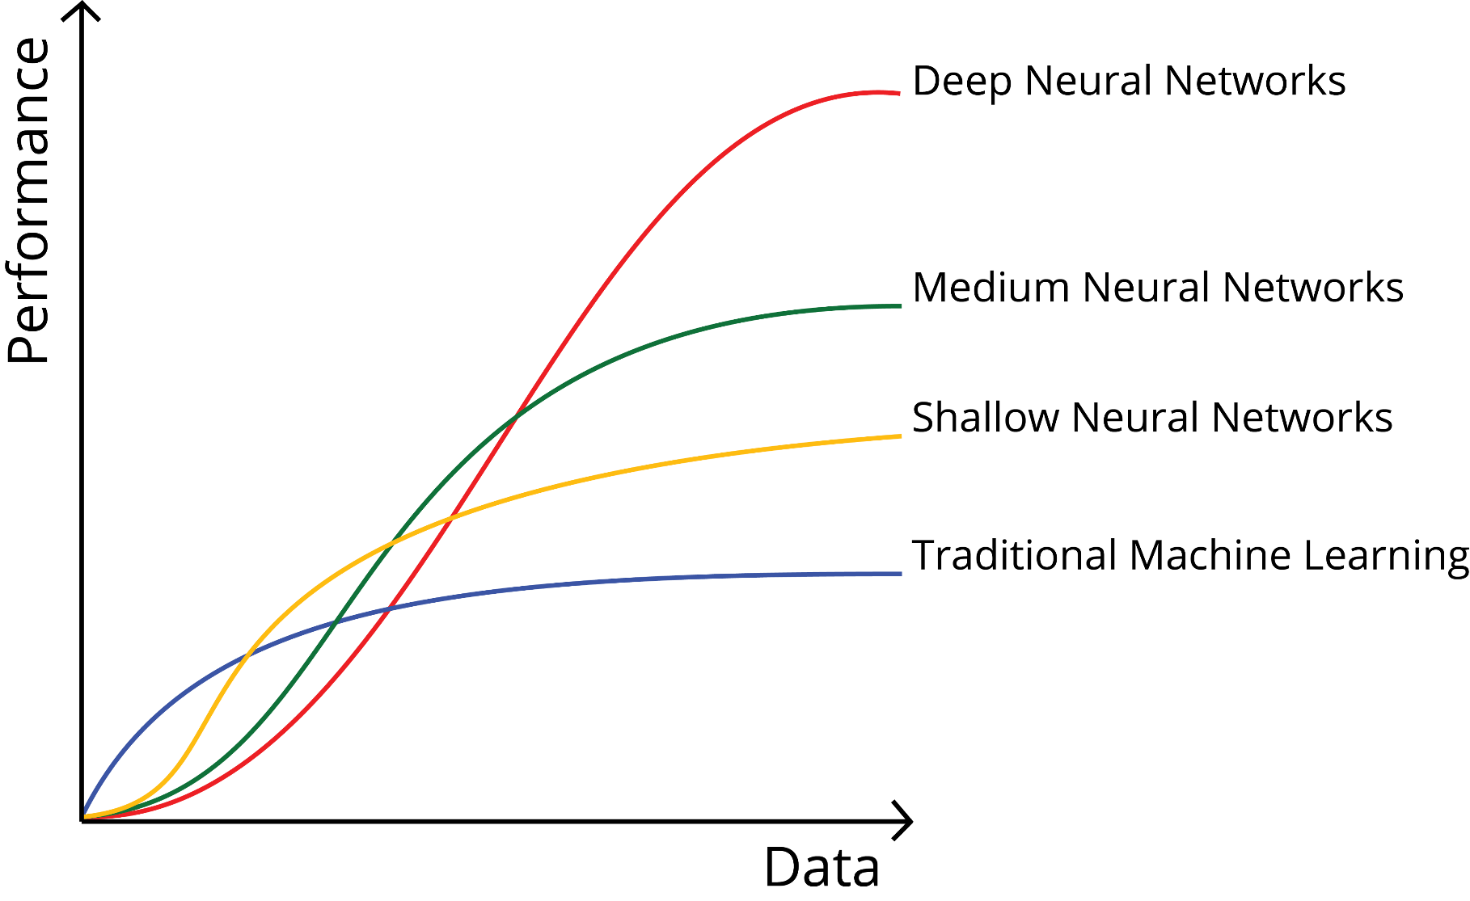
deep neural networks
Machine Learning Methods for Biomedical Data (D012554)
Notes:
Also convex!

Slide 18
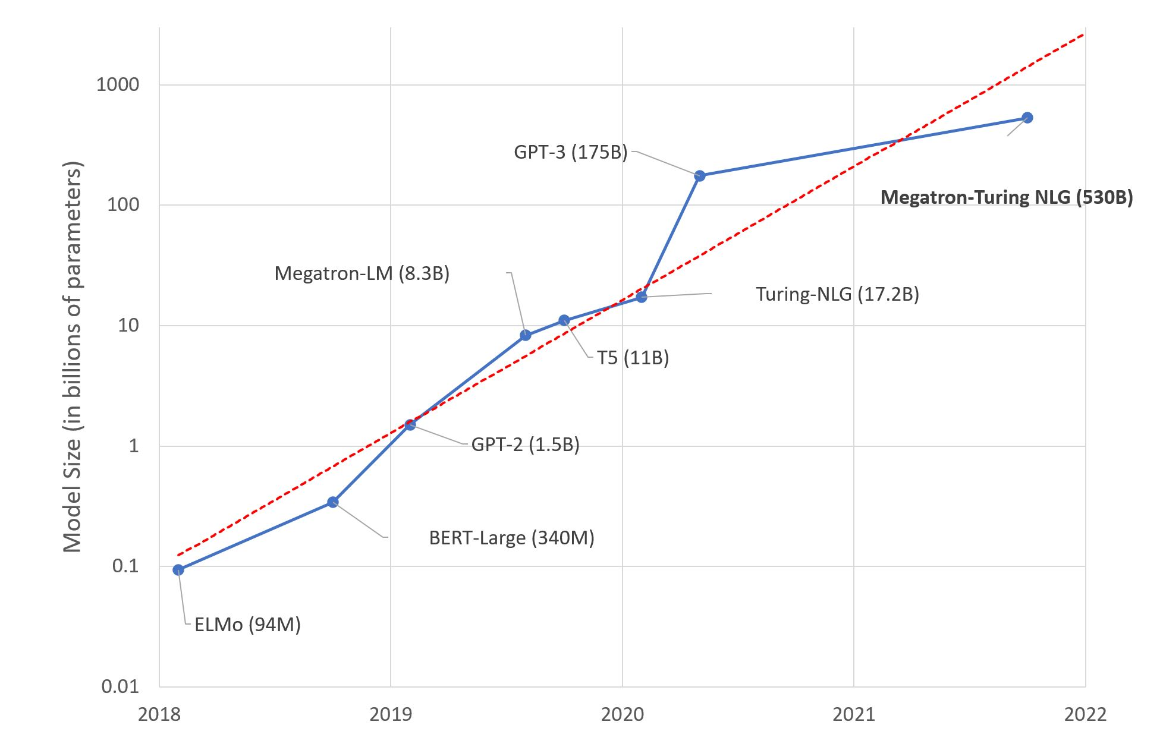
deep neural networks
AI is (for a large part) about scaling things up (logistic regression on steroids).
https://huggingface.co/blog/large-language-models
Machine Learning Methods for Biomedical Data (D012554)
Notes:
Also convex!

Slide 19
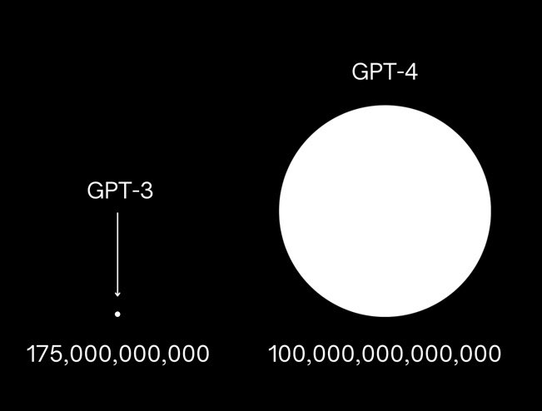
deep neural networks
AI is (for a large part) about scaling things up (logistic regression on steroids).
https://openai.com/product/gpt-4
Machine Learning Methods for Biomedical Data (D012554)
Notes:
Also convex!

Slide 20
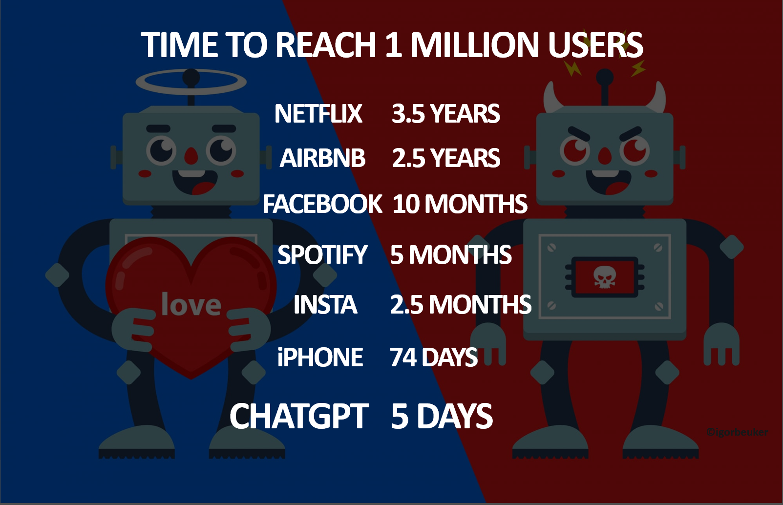
deep neural networks
AI is (for a large part) about scaling things up (logistic regression on steroids).
https://igorbeuker.com/marketing-innovation-blog
Machine Learning Methods for Biomedical Data (D012554)
Notes:
Also convex!

Slide 21
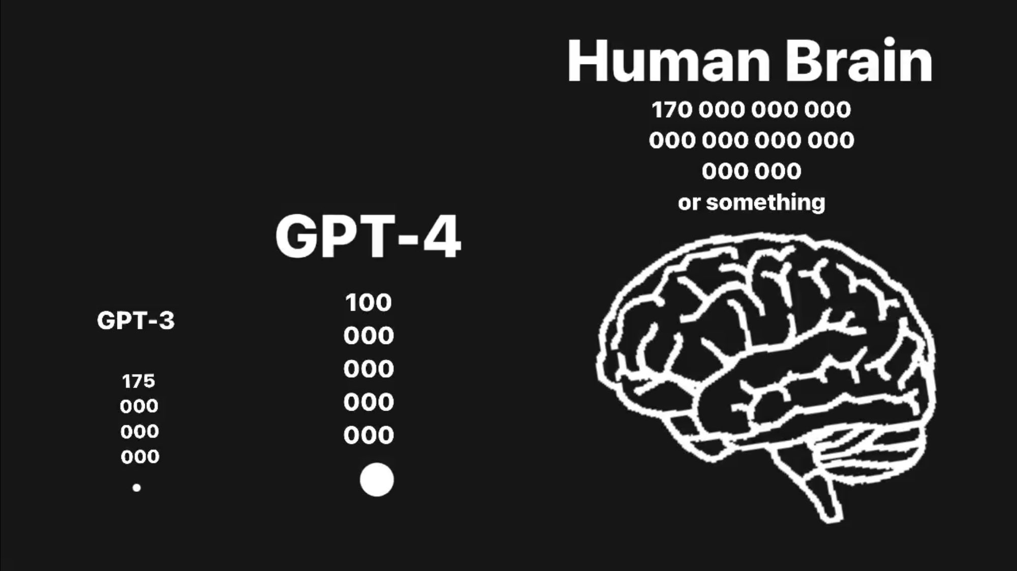
deep neural networks
AI is (for a large part) about scaling things up (logistic regression on steroids).
https://openai.com/product/gpt-4
Machine Learning Methods for Biomedical Data (D012554)
Notes:
Also convex!

Slide 22
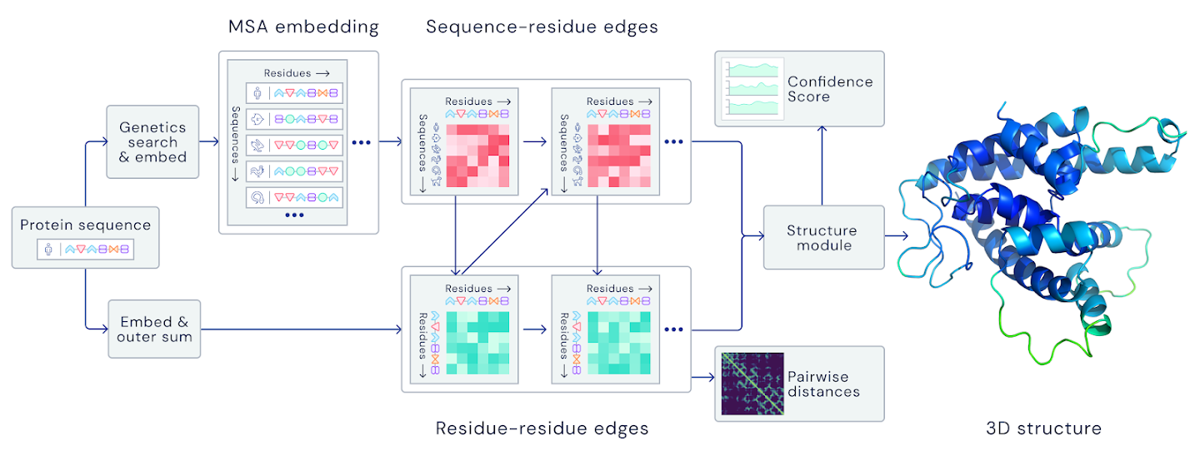
deep neural networks
AI is (for a large part) about scaling things up (logistic regression on steroids).
21 million parameters
https://www.nature.com/articles/s41586-021-03819-2
Machine Learning Methods for Biomedical Data (D012554)
Notes:
Also convex!

Slide 23
modules
AI is (for a large part) about scaling things up (logistic regression on steroids).
modules == building block == transformation == function
A module receives as input either data 𝑥or another module’s output.
A module returns an output based on its activation function.
A module may or may not have trainable modelparameters.
Machine Learning Methods for Biomedical Data (D012554)
Notes:
Also convex!

Slide 24
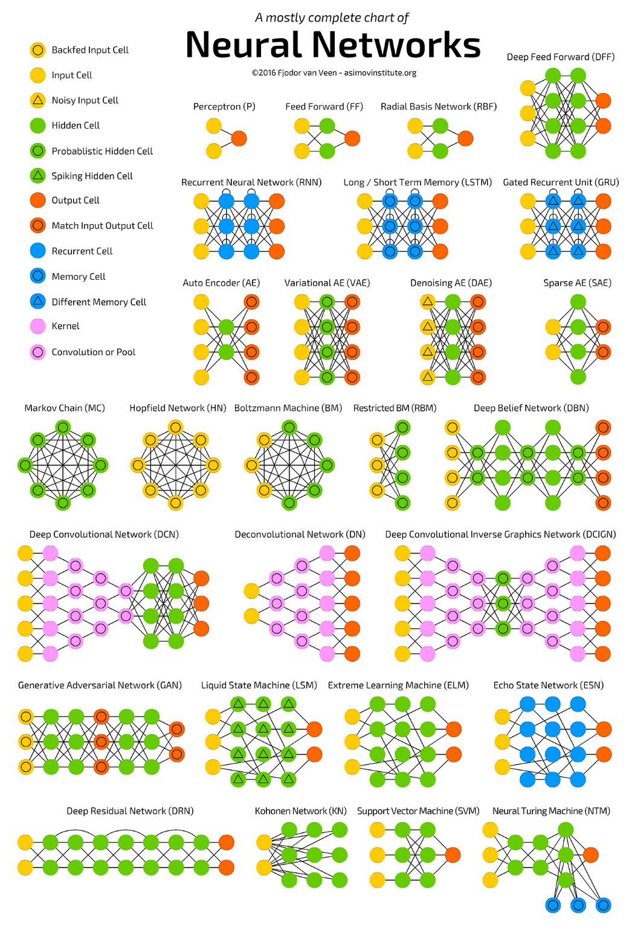
modules
Complex hierarchies of modules.
Fjodor van Veen from Asimov institute
Machine Learning Methods for Biomedical Data (D012554)
Notes:
Also convex!

Slide 25
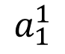
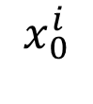








loss function
This function computes the “distance” between the output of the model and the expected output.
It defines the error the model makes.
$$x_{0}^{i}$$
$$a_{0}^{1}$$
$$x_{1}^{i}$$
$$a_{1}^{1}$$
$$x_{2}^{i}$$
$$a_{2}^{1}$$
$$a^{2}$$
$${\hat{y}}^{i}$$
$$x_{3}^{i}$$
$$a_{3}^{1}$$
…
Machine Learning Methods for Biomedical Data (D012554)
Notes:
Also convex!

Slide 26

loss function
For a regression task we use the Mean Squared Error (MSE) also known as L2 loss.
$$\frac{1}{n}{\sum_{i=1}^{n}{(y^{i}}−{\hat{y}}^{i})}^{2}$$
$$x_{0}^{i}$$
$$a_{0}^{1}$$
$$x_{1}^{i}$$
$$a_{1}^{1}$$
$$x_{2}^{i}$$
$$a_{2}^{1}$$
$$a^{2}$$
$${\hat{y}}^{i}$$
$$x_{3}^{i}$$
$$a_{3}^{1}$$
…
Machine Learning Methods for Biomedical Data (D012554)
Notes:
Also convex!

Slide 27


loss function
For a two-class (or binary) classification task we use the Binary Cross Entropy (BCE) loss.
$$−\sum_{i=1}^{n}{(y^{i}\log\left({\hat{y}}^{i}\right)+\left(1−y^{i}\right)log⁡(1−{\hat{y}}^{i})}$$
$$x_{0}^{i}$$
$$a_{0}^{1}$$
$$x_{1}^{i}$$
$$a_{1}^{1}$$
sigmoid
$$x_{2}^{i}$$
$$a_{2}^{1}$$
$${\hat{y}}^{i}$$
$$x_{3}^{i}$$
$$a_{3}^{1}$$
…
Machine Learning Methods for Biomedical Data (D012554)
Notes:
Also convex!

Slide 28








loss function
For a multi-class classification task we use the Categorical Cross Entropy (CE) loss.
$$−\sum_{j=1}^{C}{(y^{i}\log\left({\hat{y}}^{i}\right)}$$
$$x_{0}^{i}$$
$$a_{0}^{1}$$
softmax
$$\frac{e^{{\hat{y}}_{j}^{i}}}{\sum_{j=1}^{C}{e^{{\hat{y}}_{j}^{i}}}}$$
$$x_{1}^{i}$$
$$a_{1}^{1}$$
$${\hat{y}}_{1}^{i}$$
$${\hat{y}}_{1}^{i}$$
$$x_{2}^{i}$$
$$a_{2}^{1}$$
$${\hat{y}}_{2}^{i}$$
$${\hat{y}}_{2}^{i}$$
$$x_{3}^{i}$$
$$a_{3}^{1}$$
$${\hat{y}}_{3}^{i}$$
$${\hat{y}}_{3}^{i}$$
…
…
Machine Learning Methods for Biomedical Data (D012554)
Notes:
Also convex!

Slide 29






loss function
For a multi-class classification task we use the Categorical Cross Entropy (CE) loss.
$$−\sum_{j=1}^{C}{(y^{i}\log\left({\hat{y}}^{i}\right)}$$
$$x_{0}^{i}$$
$$a_{0}^{1}$$
softmax
$$\frac{e^{{\hat{y}}_{j}^{i}}}{\sum_{j=1}^{C}{e^{{\hat{y}}_{j}^{i}}}}$$
$$x_{1}^{i}$$
$$a_{1}^{1}$$
$$1$$
$$0.001$$
$$x_{2}^{i}$$
$$a_{2}^{1}$$
$$2$$
$$0.002$$
$$x_{3}^{i}$$
$$a_{3}^{1}$$
$$8$$
$$0.997$$
…
…
Machine Learning Methods for Biomedical Data (D012554)
Notes:
Also convex!

Slide 30

neural network training
The algorithm used to train a neural network is called backpropagation.
It fine-tunes the weights of a neural net based on the error rate (i.e. loss) obtained in the previous epoch (i.e. iteration).
Machine Learning Methods for Biomedical Data (D012554)
Notes:
Also convex!

Slide 31

backpropagation
https://www.youtube.com/watch?v=Ilg3gGewQ5U&t=548s&ab_channel=3Blue1Brown
Machine Learning Methods for Biomedical Data (D012554)
Notes:
Also convex!

Slide 32

loss function
Training is
a challenge.
logistic regression (small) neural network
Machine Learning Methods for Biomedical Data (D012554)

Slide 33

loss function
Training is
a challenge.
Loss surface can
be highly
non-convex.
(deep neural network)
https://izmailovpavel.github.io/curves_blogpost/
Machine Learning Methods for Biomedical Data (D012554)
Notes:
Advanced: https://www.youtube.com/watch?v=Ilg3gGewQ5U&ab_channel=3Blue1Brown

Slide 34

stochastic gradient descent (SGD)
Gradient descent (GD) takes into consideration the complete training dataset through every iteration, which may become time-consuming and computationally expensive.
GD may converge to a local minimum and may not be able to get away from it.
SGD takes into consideration one random data point through every iteration, which may lead to noisier results than the GD and may allow escaping local minima.
Machine Learning Methods for Biomedical Data (D012554)
Notes:
Advanced: https://www.youtube.com/watch?v=Ilg3gGewQ5U&ab_channel=3Blue1Brown

Slide 35

mini batch gradient descent
Mini batch gradient descent is a cross-over between GD and SGD. Instead of iterating through the entire dataset (GD) or one observation (SGD), we split the dataset into small subsets (batches) and compute the gradients for each batch.
Machine Learning Methods for Biomedical Data (D012554)
Notes:
Advanced: https://www.youtube.com/watch?v=Ilg3gGewQ5U&ab_channel=3Blue1Brown

Slide 36
encoder – decoder (autoencoder)
An autoencoder architecture learns an efficient embeddings of unlabeled data.
It consists of two parts, an encoder, and a decoder.
The encoder compresses the data from a higher-dimensional space to a lower-dimensional space (also called the latent space)
The decoder does the opposite i.e., convert the latent space back to higher-dimensional space.
latent space (embedding)
encoder
decoder
Machine Learning Methods for Biomedical Data (D012554)

Slide 37

encoder – decoder (autoencoder)
Machine Learning Methods for Biomedical Data (D012554)

Slide 38

encoder – decoder (autoencoder)
Machine Learning Methods for Biomedical Data (D012554)

Slide 39

encoder – decoder (autoencoder)
Machine Learning Methods for Biomedical Data (D012554)

Slide 40


encoder – decoder (denoising autoencoder)
Autoencoders can easily be trained to denoise image data, expression data, …
The principle is to force the latent space layer capture the most robust features by reconstructing a clean input from a corrupted one.
Machine Learning Methods for Biomedical Data (D012554)

Slide 41


variational autoencoder
In an autoencoder the latent variable is not regularized, picking a random latent variable can generate garbage output.
A variational autoencoder solves this by mapping the input image to a distribution in the latent space, rather than a single point.
Machine Learning Methods for Biomedical Data (D012554)

Slide 42

variational autoencoder
Representing chemicals in latent space to search for chemicals that optimize some function (e.g. maximize activity, or minimize toxicity).
Gómez-Bombarelli et al. ACS Central Science (2019)
Machine Learning Methods for Biomedical Data (D012554)

